Slide 1
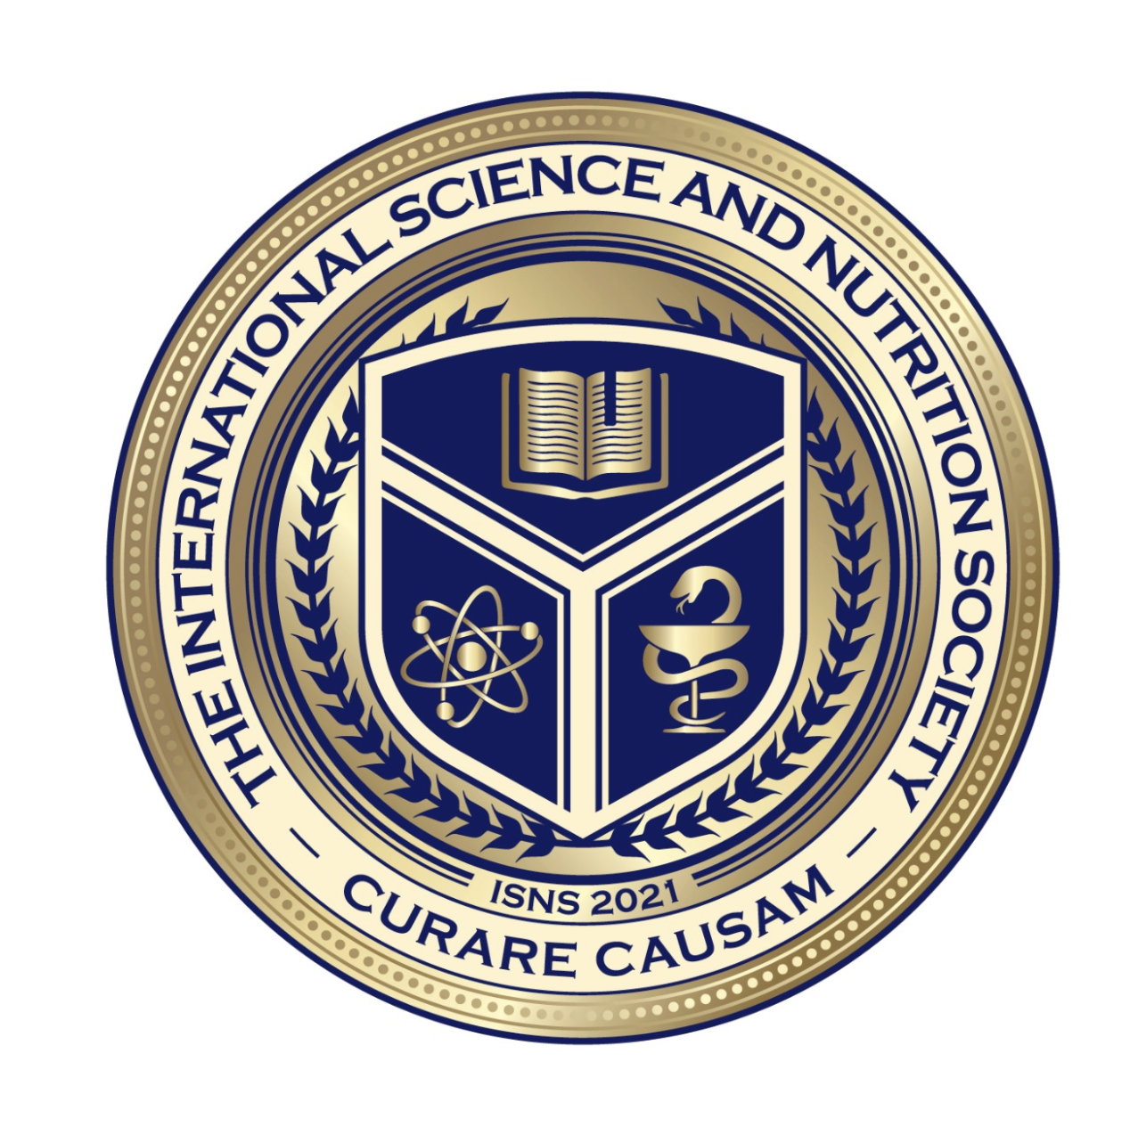
Science with Dr. Christina Rahm We will get started shortly.

Slide 2
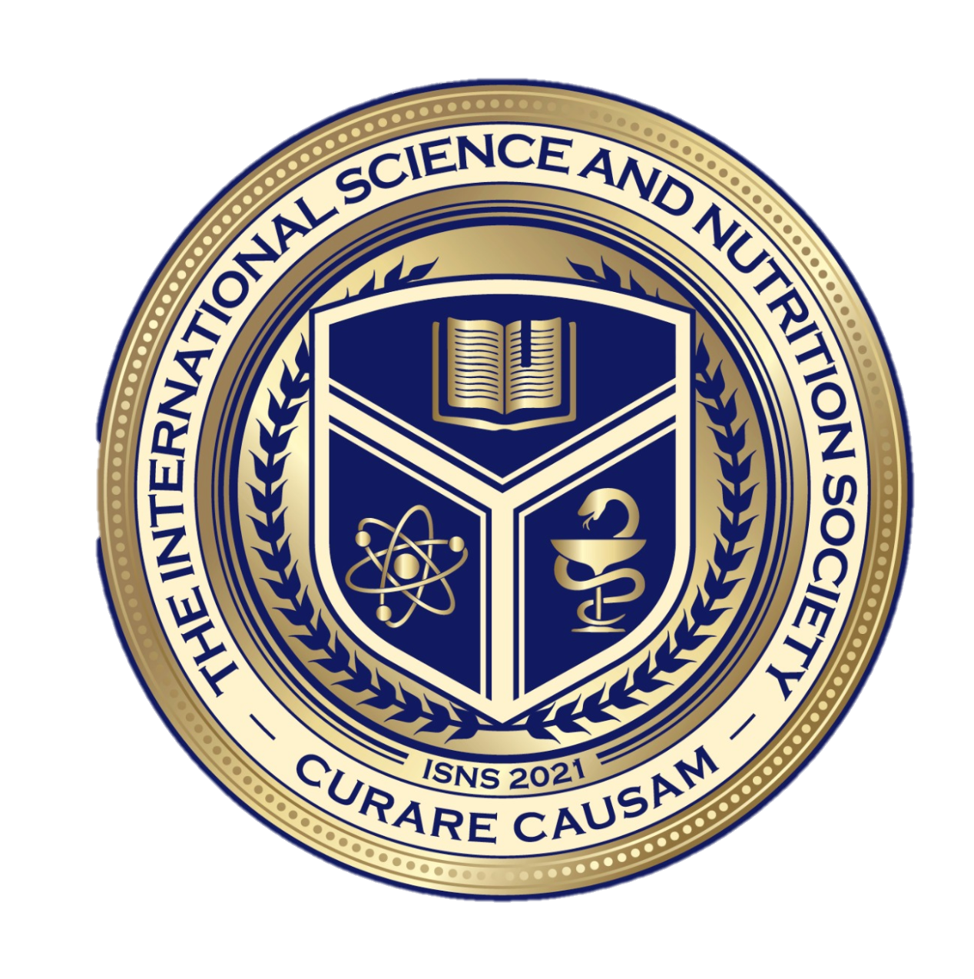
Medical Disclaimer:
The information provided is for educational purposes and is not intended as medical advice, or a substitute for the medical advice of a physician or other qualified health care professional. You should not use this information for diagnosing a health or fitness problem or disease. You should always consult with a doctor or other health care professional for medical advice or information about diagnosis and treatment.
Notes:
The information provided is for educational purposes and is not intended as medical advice, or a substitute for the medical advice of a physician or other qualified health care professional. We do not aim to diagnose, treat, cure or prevent any illness or disease. You should always consult with a doctor or other health care professional for medical advice or information about diagnosis and treatment. The information in this presentation has not been evaluated by the Food & Drug Administration or any other medical body.

Slide 3
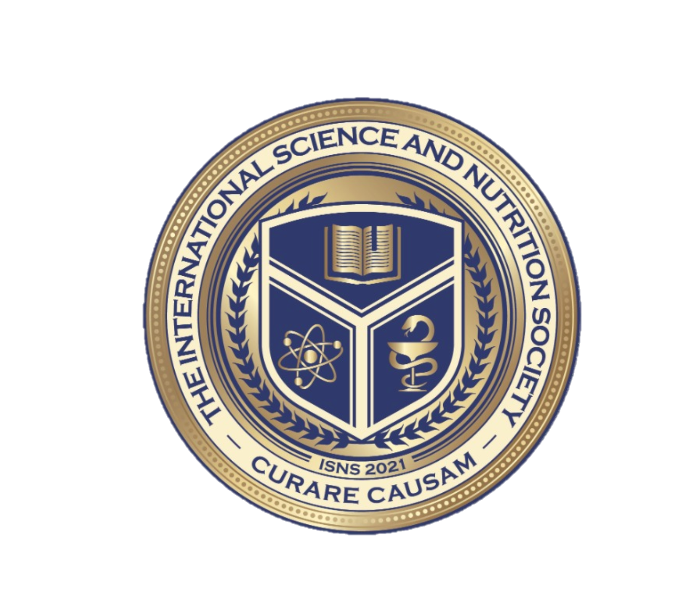
Dr. Dori Naerbo, Ph.D.
Notes:
Good morning, good afternoon, good evening…wherever you are in the world this is Dr. Dori Naerbo and I am your host on today’s call. For those of you who do not know me…I am a clinical researcher and author of several books.

Slide 4
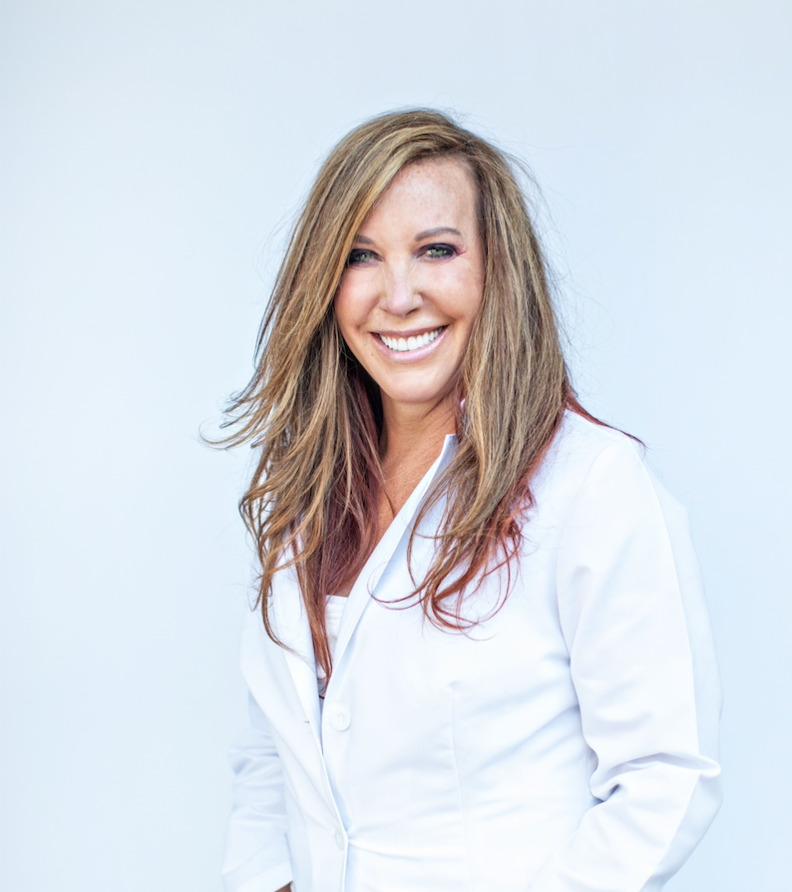
Dr. Christina Rahm CEO & Chief Science Officer

Slide 5
ISNS Case Study Presented by: Dr. Dori Naerbo

Slide 6
THE SCIENCE BEHIND THE GREENS
International Science and Nutrition Society – CURARE CAUSAM – ISNS 2021

Slide 7
IMPORTANCE OF LEAFY GREENS & FRUITS
Fruits and vegetables are rich in various vitamins and minerals that may offer a wide range of health benefits:
Control weight & aid in weight loss
Lower blood pressure
Reduce the risk of heart disease and stroke
Support a healthy digestive system
Prevent some types of cancer
Lower risk of digestive and eye problems
Support brain function
Combat viral infection

Slide 8
RESEARCH STUDIES: Vegetables, Fruits, and Disease
A meta-analysis of cohort studies following 469,551 participants found that a higher intake of fruits and vegetables is associated with a reduced risk of death from cardiovascular disease, with an average reduction in risk of 4% for each additional serving per day of fruit and vegetables.
https://www.bmj.com/content/349/bmj.g4490
Researchers found that people with high blood pressure who followed a high vegetable and fruit diet reduced their systolic blood pressure (the upper number of a blood pressure reading) by about 11 mm Hg and their diastolic blood pressure (the lower number) by almost 6 mm Hg—as much as medications can achieve.
https://www.nejm.org/doi/10.1056/NEJM199704173361601?url_ver=Z39.88-2003&rfr_id=ori:rid:crossref.org&rfr_dat=cr_pub%20%200www.ncbi.nlm.nih.gov
A cohort study of 90,476 premenopausal women for 22 years and found that those who ate the most fruit during adolescence (about 3 servings a day) compared with those who ate the lowest intakes (0.5 servings a day) had a 25% lower risk of developing breast cancer.
https://www.bmj.com/content/353/bmj.i2343.long

Slide 9
ISNS PROPRIETARY BLENDS LEGEND
Proprietary blend I: Silica, Vitamin C, and Trace Minerals
Proprietary blend II: N-acetyl L-tyrosine, Anhydrous Caffeine, L-theanine, Velvet Bean Seed, Pine Bark, Curcumin, and Vitamin D
Proprietary blend III: Black seed oil, Resveratrol, turmeric, Raspberry Ketones, Apple Cider Vinegar, Aloe Vera, and D-Ribose
Proprietary blend IV: Inulin, green banana flour, apple fiber, bacillus coagulans, spirulina, wheat grass, barley grass, alfalfa leaf, flax seed, psyllium husk, chlorella, broccoli, kale, spinach, green cabbage, parsley, Aloe Vera, cayenne pepper, blueberry, pomegranate seed, and MCT coconut oil
Proprietary blend V: Vitamin C, Zinc Sulfate, and Vitamin D3
International Science and Nutrition Society – CURARE CAUSAM – ISNS 2021

Slide 10
PROPRIETARY BLEND IV: RESEARCH STUDIES
Inulin, green banana flour, apple fiber, bacillus coagulans, spirulina, wheat grass, barley grass, alfalfa leaf, flax seed, psyllium husk, chlorella, broccoli, kale, spinach, green cabbage, parsley, Aloe Vera, cayenne pepper, blueberry, pomegranate seed, and MCT coconut oil

Slide 11
Weight Loss Associated With Consumption of Apples: A Review By Maria Conceição de Oliveira, Rosely Sichieri and Anibal Sanchez Moura
Objective: Researchers investigated the effect of apple intake on its potential to reduce body weight by various mechanisms, including antioxidant, antiproliferative, and cell signaling pathways
Results:
The feeding of apples to rats (7-10 mg/kg/d) in different forms in eight experiments have demonstrated that the consumption of apples caused weight loss during 3 to 28 weeks
Five human trials have revealed that consumption of the whole apple or apple juice (240-720 mg/d) in 4-12 weeks by overweight people can cause weight loss
https://pubmed.ncbi.nlm.nih.gov/29630462/

Slide 12
Broccoli microgreens juice reduces body weight by enhancing insulin sensitivity and modulating gut microbiota in high-fat diet-induced C57BL/6J obese mice By Xiangfei Li , Shuhua Tian , Yunfan Wang , Jie Liu , Jing Wang , Yingjian Lu
Objective: This study aimed to explore the protective effect of broccoli microgreens juice (BMJ) during mice obesity development
Results:
BMJ supplementation significantly reduced white adipose tissues (WAT) mass, the body weight and adipocyte size, and increased water intake in HFD-fed mice.
It improved glucose tolerance, reduced insulin level and HOMA-IR value, and alleviated insulin resistance
BMJ can enhance liver antioxidant capacity and reduce liver fat accumulation
https://pubmed.ncbi.nlm.nih.gov/33866422/

Slide 13
Could capsaicinoids help to support weight management? A systematic review and meta-analysis of energy intake data By S Whiting, E J Derbyshire, B Tiwari
Objective: To conduct a meta-analysis investigating the potential effects of daily consumption of capsaicinoids on weight management through reductions in energy intake
Results:
Data analysis showed that capsaicinoid ingestion prior to a meal reduced ad libitum energy intake by 74.0 kcal during the meal
Study findings suggest a minimum dose of 2mg of capsaicinoids is needed to contribute to reductions in ad libitum energy intake, which indicates there may be potential for capsaicinoids to be used as long-term, natural weight-loss aids
https://pubmed.ncbi.nlm.nih.gov/24246368/

Slide 14
Well-tolerated Spirulina extract inhibits influenza virus replication and reduces virus-induced mortality By Yi-Hsiang Chen,^{1,3} Gi-Kung Chang,¹ Shu-Ming Kuo,¹ Sheng-Yu Huang,^{1,3} I-Chen Hu,⁵ Yu-Lun Lo,¹ and Shin-Ru Shih^{a,1,2,3,4}
Objective: In this study, researchers investigated the antiviral properties of Spirulina extract on influenza strains
Results: Compared to untreated controls, the addition of 0.375, 0.75, 1.5, or 3 mg/mL of Spirulina extract respectively led to 12.12%, 22.90%, 58.73%, or 89.00% viral plaque inhibition for the H1N1 strain
Spirulina extract was found to act at an early stage of infection to reduce virus yields in cells and improve survival in influenza-infected mice, with inhibition of influenza hemagglutination identified as one of the mechanisms involved
https://www.ncbi.nlm.nih.gov/labs/pmc/articles/PMC4828654/

Slide 15
Six weeks daily ingestion of whole blueberry powder increases natural killer cell counts and reduces arterial stiffness in sedentary males and females By Lisa S.McAnultyªScott R.Collier^{b}Michael J.Landram^{b}D. StantonWhittaker^{c}Sydeena E.IsaacsªJason M.KlemkaªSarah L.CheekªJennifer C.Arms^{b}Steven R.McAnulty^{b}
Objective: Researchers investigated whether daily blueberry consumption would increase natural killer cells and plasma redox capacity and reduce blood pressure
Results: The study consisting of twenty-five men and postmenopausal women aged 18 to 50 revealed that after 6 weeks of blueberry supplementation, absolute NK cells were increased in the blueberry group, as well as reductions in aortic systolic pressures and arterial stiffness, compared to the control group
https://www.sciencedirect.com/science/article/abs/pii/S0271531714000992

Slide 16
Inulin-type fructan improves diabetic phenotype and gut microbiota profiles in rats By Qian Zhang,¹ Hongyue Yu,² Xinhua Xiao, Ling Hu, Fengjiao Xin,³ and Xiaobing Yu⁴
Objective: In this study, investigators evaluated the differences in gut microbiota composition among diabetic, inulin-treated diabetic, normal control, and inulin-treated normal control rats
Results: Inulin treatment reduced fasting blood glucose levels and alleviated glucose intolerance and blood lipid panels in diabetic rats
Inulin treatment increased the serum glucagon-like peptide-1 (GLP-1) level, reduced serum IL-6 level, and Il6 expression in epididymal adipose tissue in liver of diabetic rats
Probiotic bacteria Lactobacillus and short-chain fatty acid (SCFA)-producing bacteria were found to be significantly more abundant in the inulin-treated diabetic group than in the non-treated diabetic group
https://www.ncbi.nlm.nih.gov/labs/pmc/articles/PMC5835350/

Slide 17
REFERENCES
https://www.bmj.com/content/349/bmj.g4490
https://www.nejm.org/doi/10.1056/NEJM199704173361601?url_ver=Z39.88-2003&rfr_id=ori:rid:crossref.org&rfr_dat=cr_pub%20%200www.ncbi.nlm.nih.gov
https://www.bmj.com/content/353/bmj.i2343.long
https://pubmed.ncbi.nlm.nih.gov/29630462/
https://pubmed.ncbi.nlm.nih.gov/33866422/
https://pubmed.ncbi.nlm.nih.gov/24246368/
https://www.ncbi.nlm.nih.gov/labs/pmc/articles/PMC4828654/
https://www.ncbi.nlm.nih.gov/labs/pmc/articles/PMC4828654/
https://www.sciencedirect.com/science/article/abs/pii/S0271531714000992
https://www.ncbi.nlm.nih.gov/labs/pmc/articles/PMC5835350/
International Science and Nutrition Society – CURARE CAUSAM – ISNS 2021

Slide 18
HAPPY HOLIDAYS! THANK YOU FOR JOINING US TODAY!

